Slide 1
PATIENT CASE SIMILARITY
PIP104 University Project-II
Review-1
Batch Number:
Under the Supervision of,
Prof. Tintu Vijayan
Assistant Professor
School of Computer Science and Engineering
Presidency University
Roll Number | Student Name
20211CSD0187 20211CSD0122 20211CSD0059 | NIDHI SAINI DEEPTI AJAY NAIR SYEDA NIDA REHMAN
Name of the Program: Computer Science And Engineering (Data Science)

Slide 2
Introduction
In modern healthcare, identifying similarities between patient cases plays a critical role in diagnosing diseases, predicting outcomes, and personalizing treatments. Patient case similarity involves comparing patient profiles based on symptoms, demographics, and medical histories to determine related patterns or trends. This method aids healthcare professionals in leveraging existing case data to provide evidence-based recommendations, reducing diagnostic uncertainties and improving care quality. By utilizing machine learning techniques, patient case similarity can enhance the efficiency and accuracy of medical decision-making.
Machine learning algorithms, such as K-Nearest Neighbors (KNN) and similarity measures like cosine similarity, enable the development of systems that analyze large datasets to identify similar cases. These systems not only predict diseases but also highlight comparable cases, providing valuable context for treatment planning. Such technology fosters a data-driven approach in healthcare, offering scalability and consistency in diagnosis while empowering practitioners to make informed decisions for better patient outcomes.

Slide 3
Literature Review
 | Method | Advantages | Limitations
1. Feature-Based Similarity | Compares cases based on extracted features (e.g., symptoms, medical history) | Simplicity and ease of implementation. Effective for structured data with predefined attributes. | Limited handling of unstructured or missing data. Performance highly dependent on feature selection.
2. Text-Based Similarity (Natural Language Processing) | Uses techniques like TF-IDF, Word2Vec, or BERT to analyze textual medical records. | Handles unstructured data like clinical notes. Captures semantic relationships between terms. | Computationally expensive. Requires domain-specific language models for accuracy.

Slide 4
Literature Review
 | Method | Advantages | Limitations
3. Machine Learning Models | Utilizes supervised/unsupervised models like Random Forest, or Clustering for similarity computation. | Can handle large datasets effectively.Adaptable to various types of medical data. | Needs labeled data for supervised learning. Risk of overfitting with limited or imbalanced data.
4. Deep Learning Models | Leverages neural networks, e.g., CNNs, LSTMs, or Autoencoders, for similarity detection. | Handles complex patterns and multimodal data. Provides high accuracy for large datasets.. | Requires substantial computational resources. Challenging to interpret model decisions (black-box nature).

Slide 5
Objectives
Disease Prediction:To develop a machine learning model that can predict the disease of a patient based on their symptoms, medical history, age, and other relevant features. This prediction will aid healthcare professionals in making more informed diagnostic decisions.Patient Case Similarity Identification:To implement a mechanism that identifies and ranks historical patient cases most similar to a new patient’s profile. By leveraging similarity metrics like cosine similarity, the system can provide valuable insights from past cases to assist in treatment planning and decision-making.
Real-time Disease Diagnosis:To create a real-time, user-friendly web application using flask that allows healthcare professionals to input a new patient’s data (symptoms, demographics, etc.) and receive instant predictions of potential diseases along with similar case recommendations.Improved Healthcare Decision-Making:To support healthcare providers by offering a data-driven system that not only predicts disease but also presents similar patient cases, improving the overall decision-making process by considering past outcomes and treatments of similar patients.

Slide 6
Objectives
Scalability and Extensibility:To design the system in a way that it can scale to accommodate more patients and diseases. The system should allow easy updates as new patient data and medical research become available, ensuring it remains accurate and relevant over time.Integration with Medical Databases:To integrate the system with existing medical databases or electronic health records (EHR) for seamless data retrieval, enhancing its accuracy and enabling broader use in clinical settings.User Experience and Accessibility:To ensure the system is accessible to healthcare professionals through an intuitive web interface powered by flask, with easy-to-navigate features that present predictions and similar cases clearly and effectively.

Slide 7
Methodology:
Data Collection & Preprocessing
Data Acquisition:
Collect patient data including symptoms (fever, cough, etc.), medical history, demographics (age, gender), and disease outcomes.
Data can come from healthcare records or be manually generated.
Data Cleaning & Transformation:
Handle missing data (imputation or removal).
Label Encoding for categorical features (e.g., symptoms, gender).
Feature Scaling for numerical values (age) using StandardScaler.
Data Splitting:
Split the dataset into training (80%) and testing (20%) sets for model evaluation.

Slide 8
Methodology:
Model Training & Similarity Analysis
Model Selection:
Use K-Nearest Neighbors (KNN) for disease prediction, based on patient feature similarity.
Model Training:
Train KNN using the training dataset, and tune hyperparameters (number of neighbors).
Evaluate model performance using accuracy, precision, recall, and F1-score.
Similarity Analysis:
Cosine Similarity measures the similarity between a new patient's features and historical cases.
Rank cases based on similarity scores, identifying the most relevant cases.

Slide 9
Methodology:
flask Integration & Deployment
flask Web Application:
Design a user-friendly interface where healthcare professionals input patient data.
Provide real-time disease prediction and display similar patient cases based on the input.
Backend Logic:
The flask app processes patient data, passes it to the trained KNN model, and computes similarity scores.
Displays predictions and similar cases in an intuitive format.
Deployment & Continuous Improvement:
Deploy the system on a cloud platform or local server.
Continuously retrain the model with new patient data and feedback to improve accuracy and predictions.

Slide 10
Timeline of Project
 | Start Date | End date
Planning | 20 Sept, 2024 | 28 Sept, 2024
Research | 29 Sept, 2024 | 18 Oct, 2024
Training the model | 19 oct | 27 nov
Testing the model | 19 oct | 27 nov
Final outcome | 12th Dec | 27th Dec

Slide 11
Expected Outcomes
Accurate Disease Prediction:
The system will provide accurate disease predictions based on patient symptoms and medical history,
helping healthcare professionals make informed decisions.
Similar Case Identification:
The system will identify and rank similar patient cases using cosine similarity, allowing healthcare
professionals to explore historical cases for treatment insights.
Enhanced Decision-Making:
By integrating machine learning with real-time predictions and case similarity, the system will assist
in better diagnosis, treatment planning, and patient management.
Scalability and Continuous Improvement:
The system will be scalable to handle more data, and the model will continuously improve
through regular updates with new patient data and feedback.
Efficient Healthcare Support:
With a flask-based interface, the system will provide an intuitive platform for healthcare
professionals, enabling easy access to predictions and relevant patient cases.

Slide 12
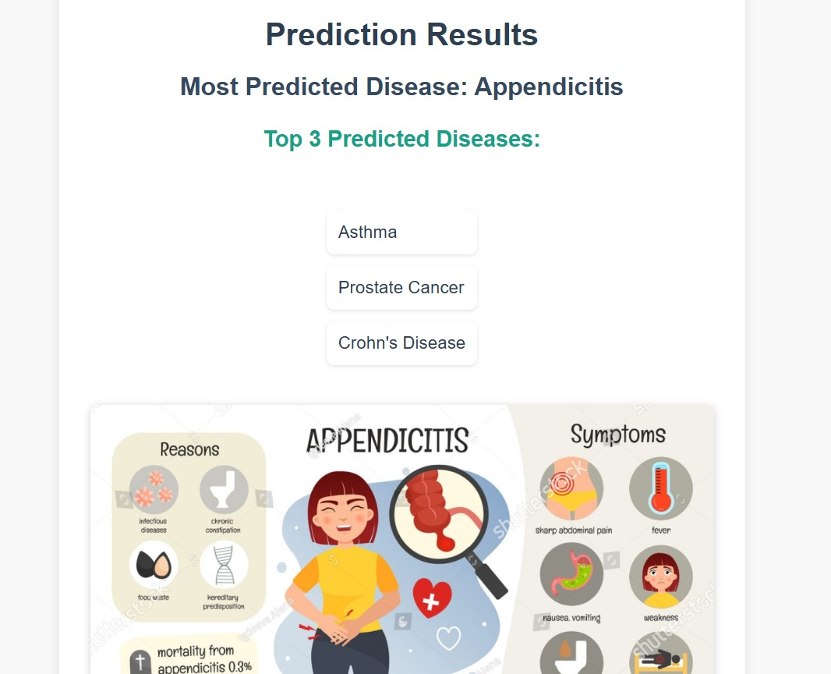
Output

Slide 13
Conclusion
The patient case similarity system developed in this project provides an efficient platform for comparing medical cases based on key attributes like symptoms, medical history, and treatment outcomes. Built using flask, the system combines user-friendly web interfaces with robust data processing techniques, enabling healthcare professionals to quickly identify similar cases and derive insights for evidence-based decision-making. This tool demonstrates the potential of technology in enhancing clinical workflows, offering a scalable and reliable solution to improve patient care through personalized treatment recommendations.
Looking ahead, this project lays the groundwork for further advancements in healthcare technology. Future developments could include integrating the system with Electronic Health Records (EHR) for real-time data access and incorporating machine learning models to enhance the accuracy of similarity detection. Expanding its use to other domains like rare disease research or large-scale epidemiological studies could significantly broaden its impact. Ultimately, this project highlights the transformative role of data-driven tools in advancing healthcare outcomes and supporting medical professionals

Slide 14
References
“Prediction and early warning method of inundation process at waterlogging points based on Bayesian model average and data-driven” by Yihong Zhou, Zening Wu, Hongshi Xu, Huiliang Wang
“Prediction of waterlogged zones under heavy rainfall conditions using machine learning and GIS tools: a case study of Mumbai” by Sunil Khatri · Pravin Kokane Shubham Pawar
“Urban Flood Forecast System - A Case study of Bangalore, India ” by Shubha Avinash 1, Dr. K Lakshmi Prasad 2, Dr. G. S Srinivasa Reddy 3, Dr. D Mukund
“Urban waterlogging prediction and risk analysis based on rainfall time series features : A case study of shenzhen” by Zongjia Zhang, Xinyao Jian, Yiye Chen, Zhejun Huang, Junguo Liu and Lili Yang.
“Amulti-strategy-mode waterlogging-prediction framework for urban flood depth” by Zongjia Zhang, Xinyao Jian, Yiye Chen, Zhejun Huang, Junguo Liu and Lili Yang.

Slide 15
Thank You

